Slide 1

Governing Body
Annual Report to Parents
2024-2025

Slide 2
Contents | Page
Term dates | 3
Introduction | 4
Governing Body Members | 5
Financial Summary 2024-25 | 6
Attendance Summary 2024-2025 | 7
School Development Plan Summary 2024-2025 | 8
School Development Priorities 2025-2026 | 11
AoLE Leads | 12

Slide 3
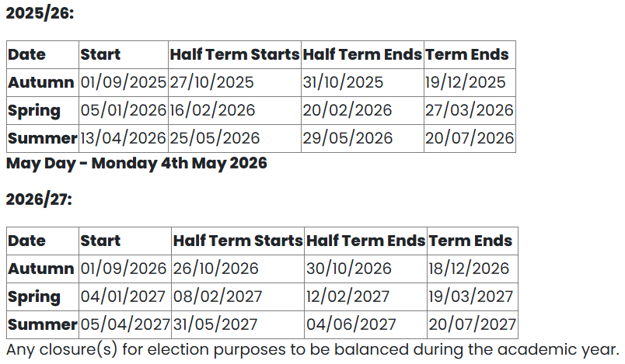
Blaenau-Gwent Term Dates

Slide 4
Dear Parents, Guardians and Carers,
On behalf of the Governing Body, I am delighted to introduce this year’s Annual Report. As always, our first priority is the well-being, learning and development of every child in our school community.
I would like to take this opportunity to express my heartfelt thanks to all our staff. Their dedication, professionalism and unwavering commitment to the children’s well-being and education have been truly inspiring over the past year. The care, creativity and resilience they demonstrate every day make a tangible difference to our pupils and families.
We were also delighted to welcome Mrs Amy Skuse, who joined us as Deputy Headteacher in the Spring Term. She has already made a significant impact with her work on attendance, bringing fresh ideas and enthusiasm to the leadership team, and we look forward to the continued positive contributions she will make in the years ahead.
Together, Staff, Governors and Parents continue to work in partnership to provide the very best opportunities for our children. Thank you for your ongoing support as we look forward to another successful year.
Yours sincerely,
Mrs Kim Evans
Chair of Governors

Slide 5
Governing Body Members
Governing Body Position | Member
Chair | Kim Evans
Vice-chair | Kerys Beese
Reserve Member | Simon Anthony
LA Appointed Governors | Rev. Lorette Hinson Sarah Jones
Community Governors | Michael Williams Glyn Morvan
Parent Governors | Graeme Kerr Amy Price Zachary Meakin Caroline Hernon-Biggs
Teacher Governor | Shaun Pugh
Staff Governor | Rachael Davies
Clerk to Governing Body | Claire Mower

Slide 6
Financial Summary 2024-2025
Expenditure Category | Costs (GBP)
Employee Costs | 1,715,394
Other Employee Costs | 75,711
Energy | 53,000
Resources | 50,000
Premises | 116,080
Central Services | 143,442
Miscellaneous | 3,097
Net expenditure | 2,146,724
Income Category | Costs (GBP)
Main Budget | 1,868,326
EAS Grants | 17,251
LA Grants | 61,872
Pupil Deprivation Grants | 82,808
Net Income | 1,947,249
Surplus used for shortfall (ratified by Governing Body).

Slide 7
Attendance Summary 2024-2025
Nursery to Year 6
Term | Attendance % | Authorised Absence % | Unauthorised Absence %
Autumn | 91.1 | 0.85 | 0.1
Spring | 92 | 0.36 | 0.14
Summer | 89.4 | 0.69 | 0.34
Total | 90.9 | 0.64 | 0.19
Reception to Year 6
Term | Attendance % | Authorised Absence % | Unauthorised Absence %
Autumn | 91.2 | 0.85 | 0.11
Spring | 92.1 | 0.35 | 0.12
Summer | 89.5 | 0.69 | 0.34
Total | 91 | 0.64 | 0.18

Slide 8
School Development Plan Summary 2024-2025
Each year we identify key priorities to help every child thrive academically, socially and emotionally. These priorities guide our teaching, professional learning and the way we shape the learning environment. We’re pleased to share with you a summary of our progress over the past year. It highlights the steps we’ve taken and the positive impact on pupils.
Priority 1: Improving Pupils’ Welsh Language Skills We have focused on helping pupils grow in confidence and ability when speaking Welsh. Many children have made clear progress from their starting points, and most are now able to hold simple conversations suited to their stage of development. We have been using Cymraeg Bob Dydd across the school to encourage everyday Welsh, especially in Years 1 and 2, and have increased the visibility of the language through bilingual signs, displays and classroom resources. This helps immerse pupils in Welsh naturally throughout the school day. We are also developing pupils’ reading skills in Welsh through guided and shared reading, and continuing our work towards achieving the Siarter Arian award. As a result, pupils show growing enthusiasm, confidence and pride in their bilingual identity, and Welsh is becoming an even more vibrant and integral part of daily school life. | Priority 2: Strengthening Pupils’ Numeracy Skills Across the Curriculum We are giving pupils more meaningful opportunities to apply their maths skills in real-life and cross-curricular contexts. Many children already have a positive attitude towards mathematics, and we are building on this enthusiasm by: Embedding recent staff training to provide regular reasoning and problem-solving opportunities. Using fewer worksheets and more hands-on, concrete resources to deepen understanding. Improving classroom maths areas and bilingual labelling so pupils can access high-quality support independently. Leaders have also introduced regular recorded “maths challenges” in pupils’ books, ensuring every child takes part in problem-solving activities at least twice a week. Teachers are making greater use of displays, large dry-wipe boards, and visual resources to model current learning more clearly. Staff training on reasoning, problem-solving and innovative tools (including AI) is beginning to enrich teaching and help pupils connect maths to authentic, real-life situations. Although this work is at an early stage, it is already having a positive impact and will continue to strengthen pupils’ mathematical confidence and competence.

Slide 9
Priority 3: Improving Spelling, Punctuation and Grammar Across the School We have continued to focus on raising standards in pupils’ spelling, punctuation and grammar. All pupils have made progress from their individual starting points, and we are working to strengthen consistency in teaching and feedback across the school. We are increasing opportunities for extended and independent writing, particularly in the Early Years and Progression Step 2, and improving the systematic teaching of grammar and vocabulary. Teachers are embedding clear success criteria and self-assessment strategies so that pupils understand how to improve their work. Differentiation remains a focus to ensure all pupils are both supported and challenged effectively. While Progression Step 3 shows stronger writing outcomes, our whole-school approach is now creating more opportunities for pupils to develop their skills in every year group. This work will continue next year, with a sharper focus on feedback, extended writing and independent application of grammar and spelling. | Priority 4: Balancing Child-Initiated and Adult-Directed Learning in the Early Years We have made steady progress in developing a more balanced approach between adult-directed teaching and child-initiated exploration in the Early Years. Many children are now able to sustain interest in activities they have helped to shape, showing greater independence, curiosity and resilience. Staff have undertaken professional learning to improve the quality of interactions during play, and we have enhanced our use of observation and pupil voice in planning. Learning environments have been reorganised to make them more accessible and engaging, supporting children’s independence and ownership of their learning. This work has already strengthened the nursery-to-reception pathway and supported staff understanding of developmentally appropriate provision. We will continue to build staff confidence in balancing direct teaching with child-led exploration, ensuring a consistent and stimulating Early Years experience for all pupils.

Slide 10
Priority 5: Improving Attendance Across the School We have placed a strong focus on improving attendance and are pleased to report positive results. Overall attendance for statutory school-age pupils rose from 89.0% in 2023–24 to 91.5% in 2024–25, moving us closer to our target of 92%. Nearly all groups have shown improvement, reflecting the impact of targeted parental engagement, closer monitoring, and pastoral support. Pupils are increasingly aware of the importance of attendance and have responded positively to new initiatives such as half-termly attendance certificates. While we have seen a slight widening of the attendance gap between some groups, authorised absences have decreased and lateness has improved overall. We will continue to build on these gains, focusing on narrowing the attendance gap between groups and supporting families where persistent absence remains a challenge. | Priority 6: Strengthening Pupil Voice and Leadership Opportunities We have expanded pupil leadership opportunities this year by establishing seven pupil voice groups, each with clear roles and responsibilities. Pupil representatives have begun gathering and sharing the views of their peers, contributing to wider meetings and influencing change within the school. We are now developing a whole-school pupil leadership framework to connect the Senedd and individual groups more strategically. Termly reporting and regular assemblies will allow each group to share progress and impact with the whole school community. This work is helping pupils develop leadership skills, take responsibility, and play a meaningful role in shaping school improvement priorities. By widening participation in initiatives such as Heddlu Bach and Expressive Explorers, we are giving more children the chance to develop confidence, teamwork and citizenship skills.

Slide 11
School Development Plan Priorities 2025-2026
Improving Feedback and Marking
We’re making sure children understand what they’re learning, what success looks like and how to improve their work. Teachers are giving clearer feedback and using success criteria to help every child make progress.
Raising Reading Standards
We’re helping every child become a confident reader by developing fluency, comprehension and a real love of reading across all age groups.
Boosting Attendance
We’re working closely with families to reduce persistent absence. Our focus is on early support, clear communication and personalised plans so children come to school regularly and don’t miss out on learning.
Strengthening School Leadership
We’re developing strong leadership and self-evaluation processes to ensure we’re always improving teaching, learning and pupil progress across the school.

Slide 12

Who we are and what we do!
Parent surveys have shown us that you would like to know more about the roles of staff across the school.
Our Area of Learning and Experience Leads have put some information together for you to explain a little more about their area and what they do!

